Slide 1
PRPGRAMMING SKILLS PORTFOLIO
(EXERCISES OUTPUT)
By-Ahmad Salman khan

Slide 2
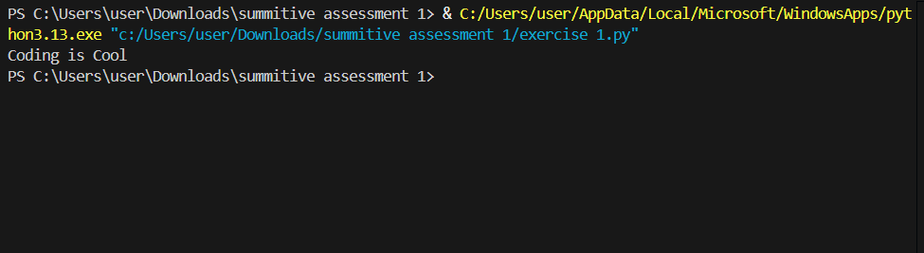
EXERCISE 1

Slide 3
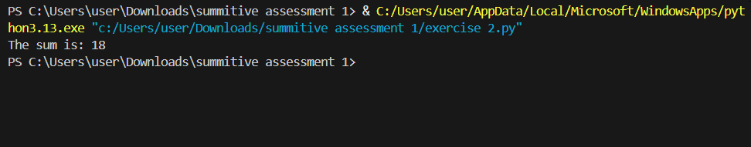
EXERCISE 2

Slide 4
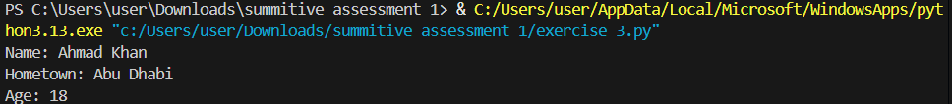
EXERCISE 3 BASIC

Slide 5
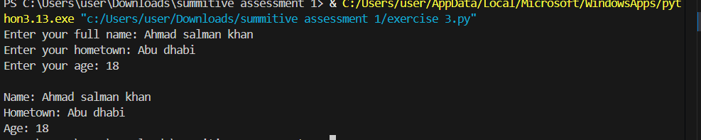
EXERCISE 3 ADVANCE

Slide 6
EXERCISE 4 BASIC

Slide 7
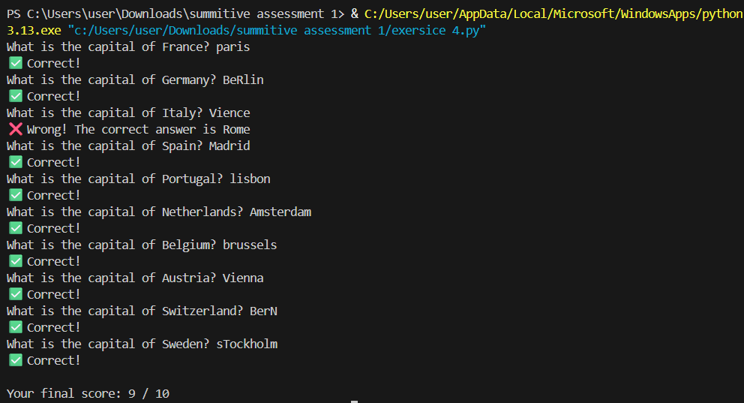
EXERCISE 4 ADVANCE

Slide 8
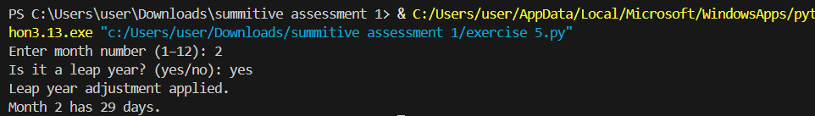
EXERCISE 5 BASIC AND ADVANCE COMBINED

Slide 9
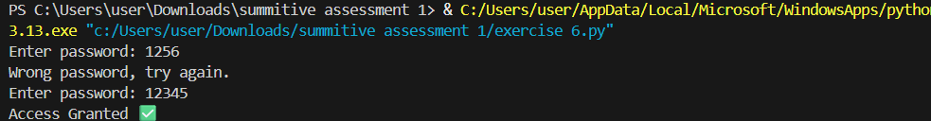
EXERCISE 6 BASIC

Slide 10
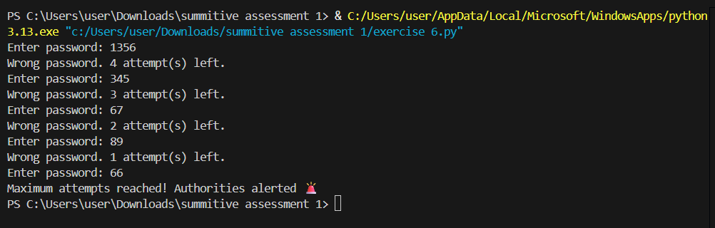
EXERCISE 6 ADVANCE

Slide 11
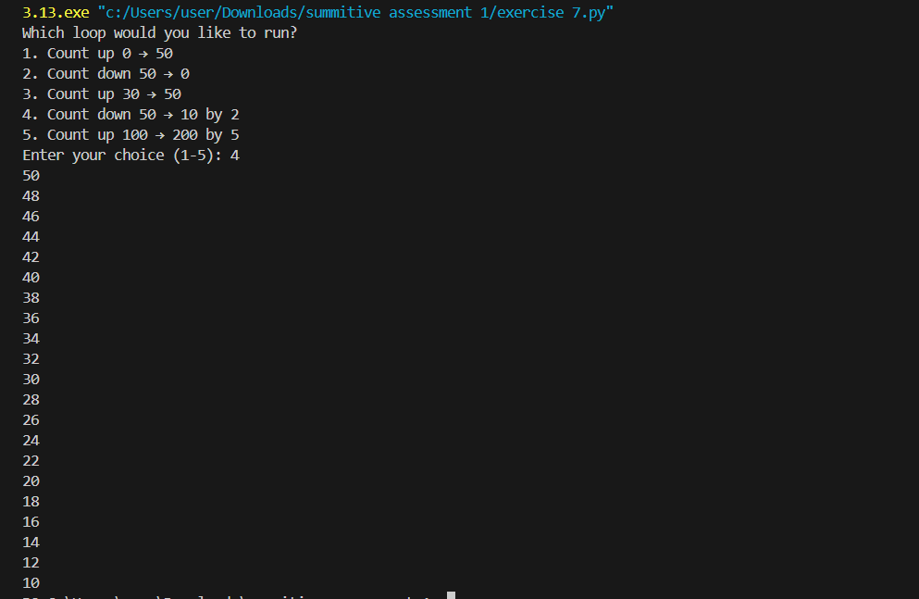
EXERCISE 7

Slide 12
EXERCISE 8 BASIC

Slide 13
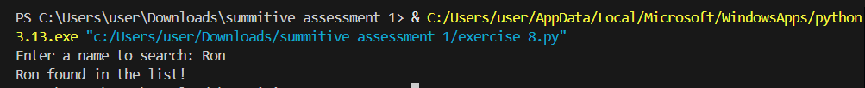
EXERCISE 8 ADVANCE

Slide 14
EXERCISE 9

Slide 15
EXERCISE 10

